Slide 1

WELCOME
To The Presentation
1

Slide 2
ONLINE BANKING APPLICATION
Presented by:
Rajani H
Dheeraj S
Priyanka I
Ruthu G
Chaitra K
2

Slide 3
Contents
Problem statement
Short Description
Application modules
Design
Technologies used
Results
Conclusion
3

Slide 4
Problem Statement
The banking industry is witnessing a revolution in products, process, markets and regulations. And it’s a revolution that is not about to stop or even slow down. Since the only option is to adapt and evolve. It is essential that system have the flexibility to quickly adjust the need of today's financial market.
The need to retain the old customers and attract the new Ones's , reduce the costs and improve the efficiency , save ones precious time. Online banking system can help to meet and overcome them.
4

Slide 5
Description
Online banking allows a user to conduct financial transactions via the internet.
It offers customers almost every service traditionally available through a local branch including deposit money, transfer money , bank statement etc.
Online banking web application provides a user friendly interface to perform the required task being at a same place , also saving ones precious time.
5

Slide 6
Application Modules
Register Module
Login module
Bank statement
Deposit money
Fund transfer
A user can add a new account.
A user can login with id & password.
A user can view balance & transactions.
A user can add money.
A user can transfer money.
6

Slide 7
Design of Banking Application
Customer
INTERNET
User Interface
Login
Server
Data
Base
Register
Deposit
Transfer
Backend Process
Bank statement
7

Slide 8
Technologies Used
Front End :
HTML
CSS
Bootstrap
Java script
Created using Dynamic web project.
8

Slide 9
Technologies Used
2. Back end:
Spring boot
Java Programming language
Created using Maven project
Data Base: MySQL
3. Others: Windows OS, Dependencies
9

Slide 10
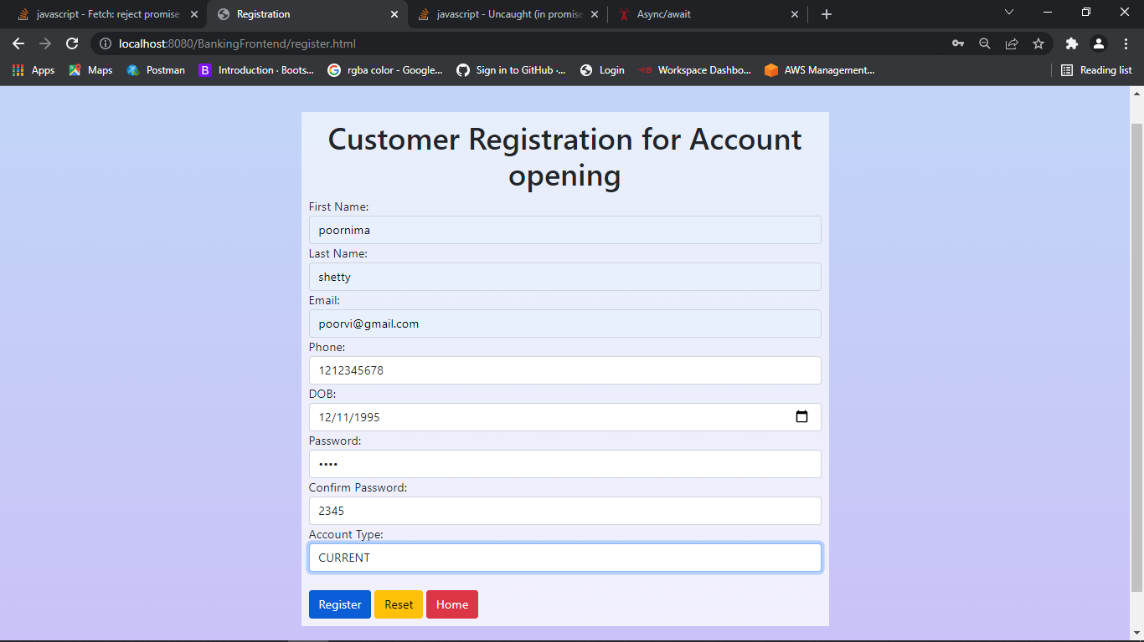
Results
10

Slide 11
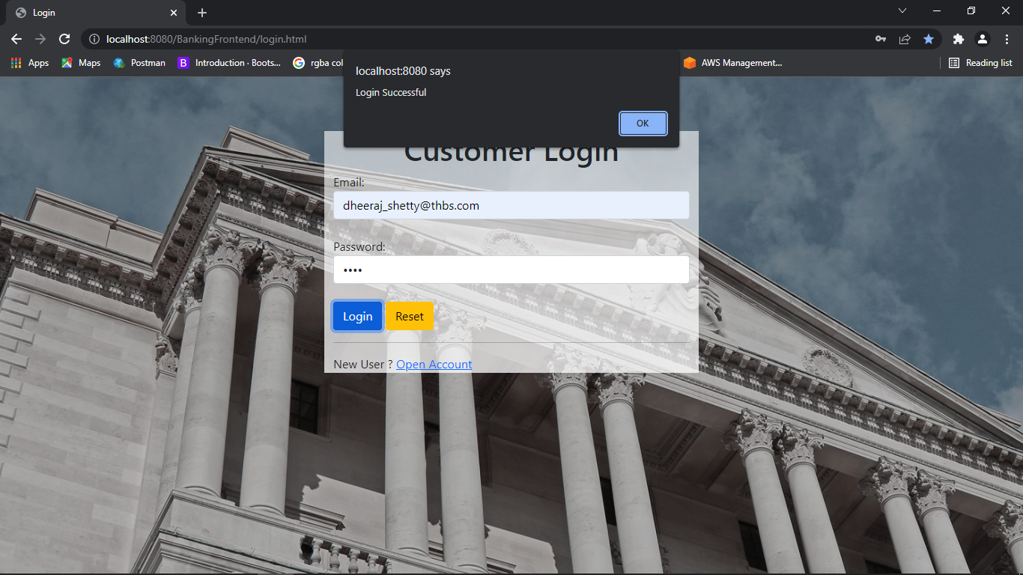
Login Page
11

Slide 12
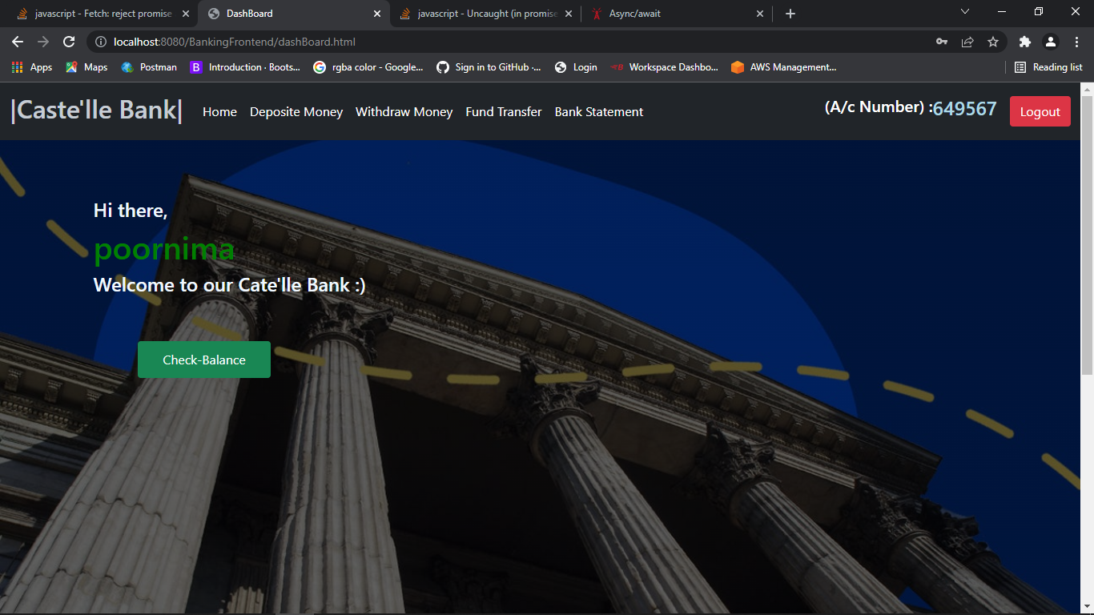
User interface
12

Slide 13
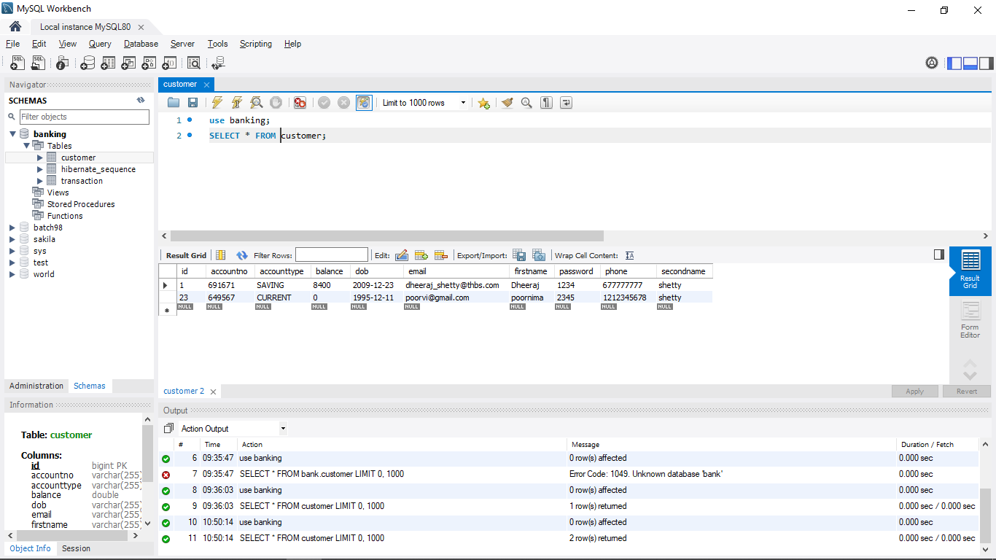
Database
Database AFTER registration
13

Slide 14
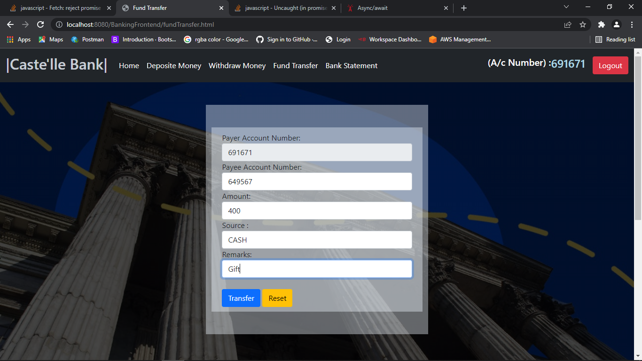
Fund transfer
14

Slide 15
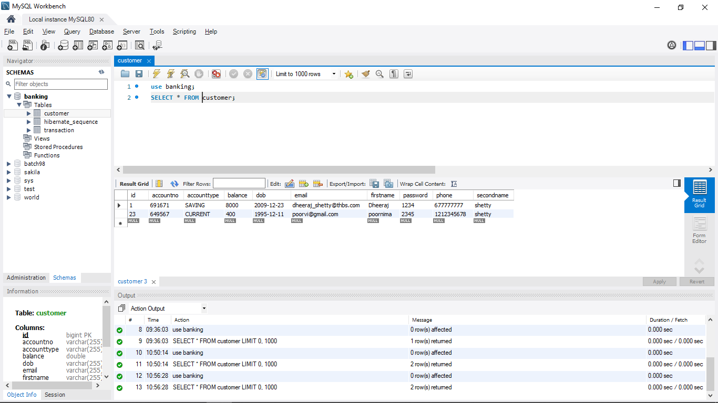
Database AFTER FUND TRANSFER
15

Slide 16
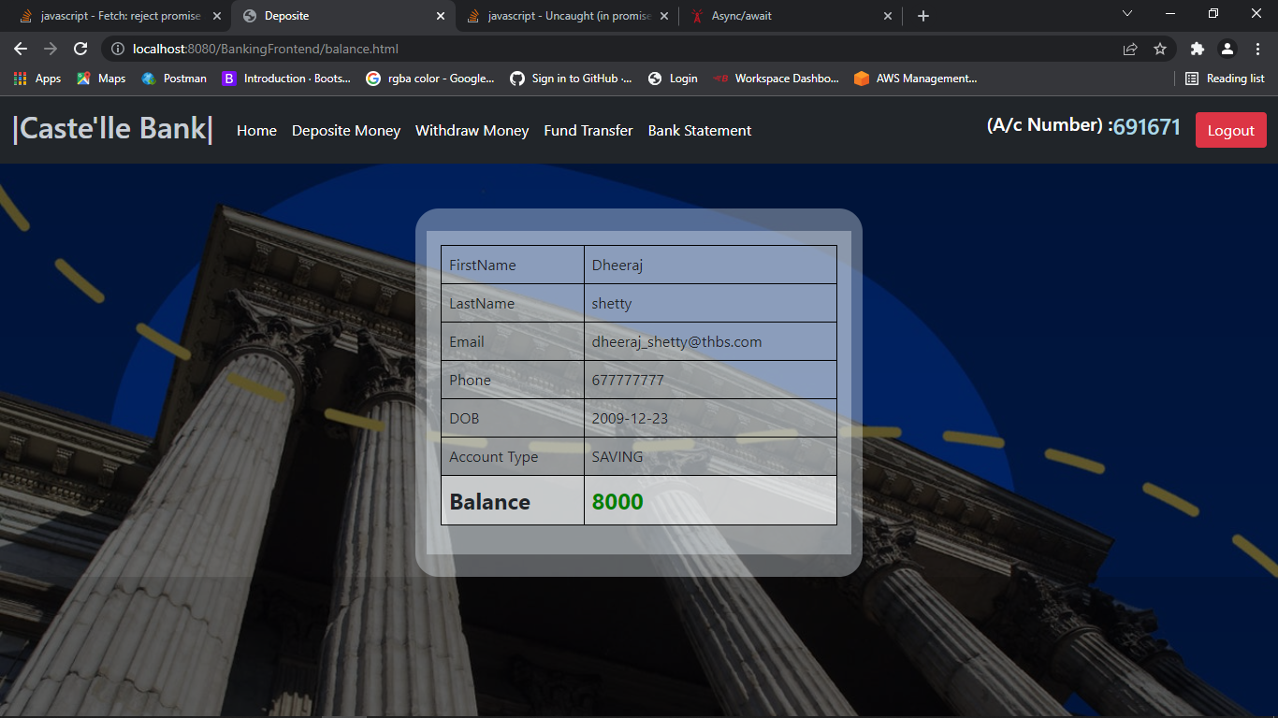
BALANCE
16

Slide 17
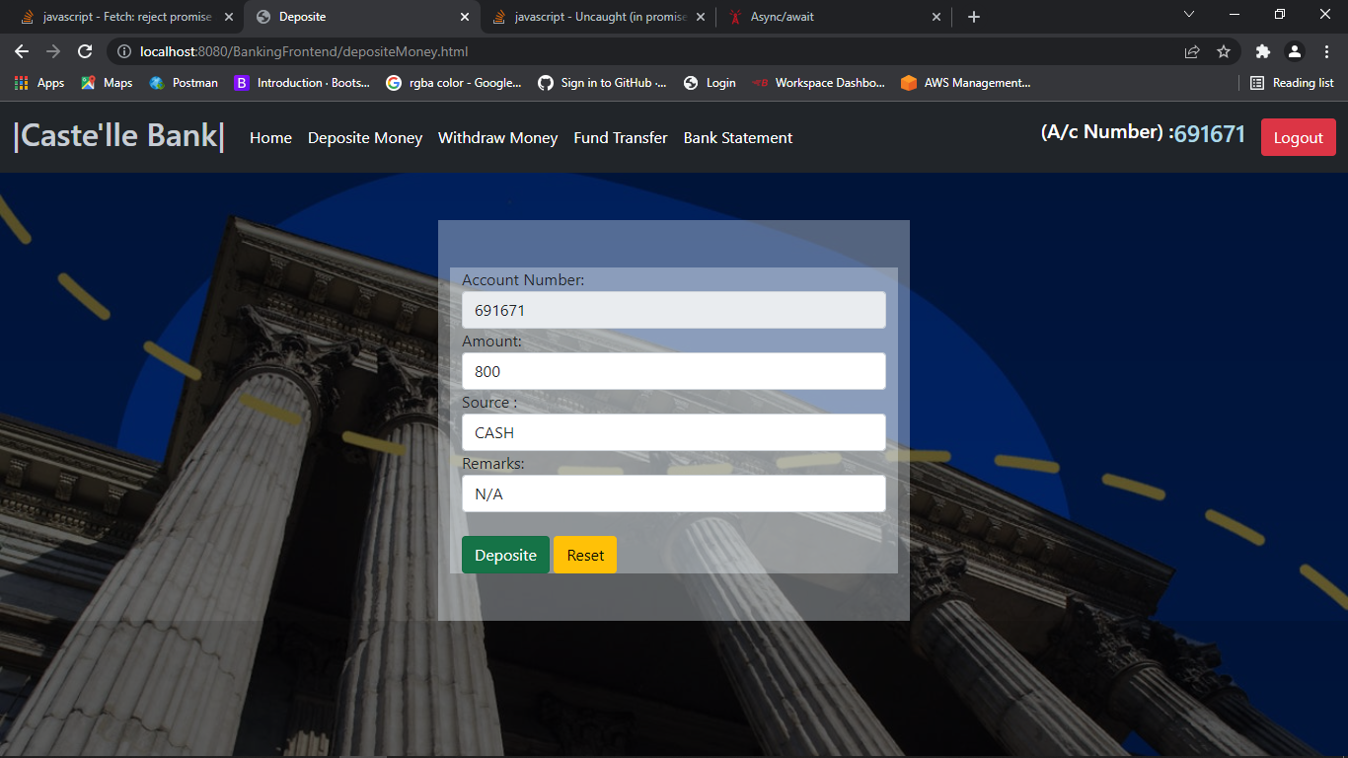
Deposit Money
17

Slide 18
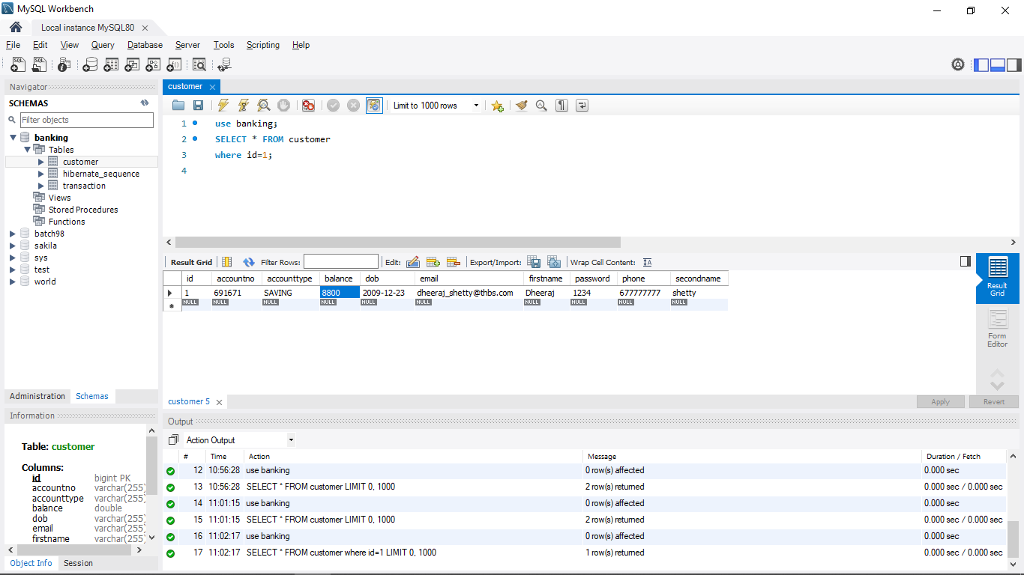
800 deposited to account nor 691671
18

Slide 19
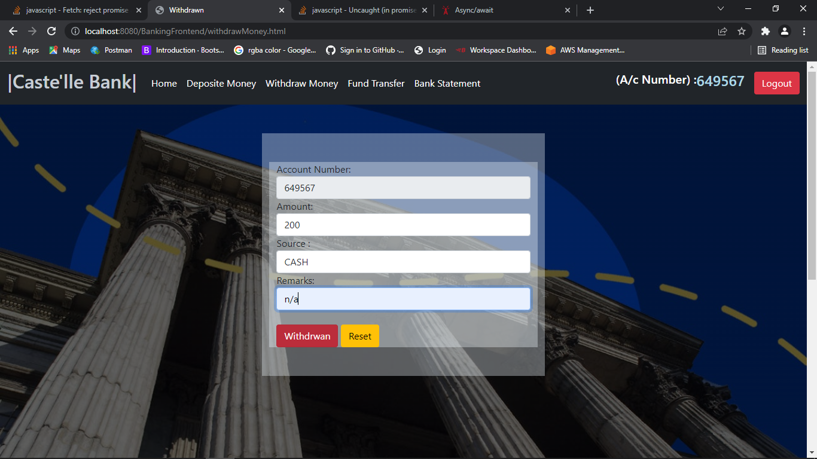
Withdraw Money
19

Slide 20
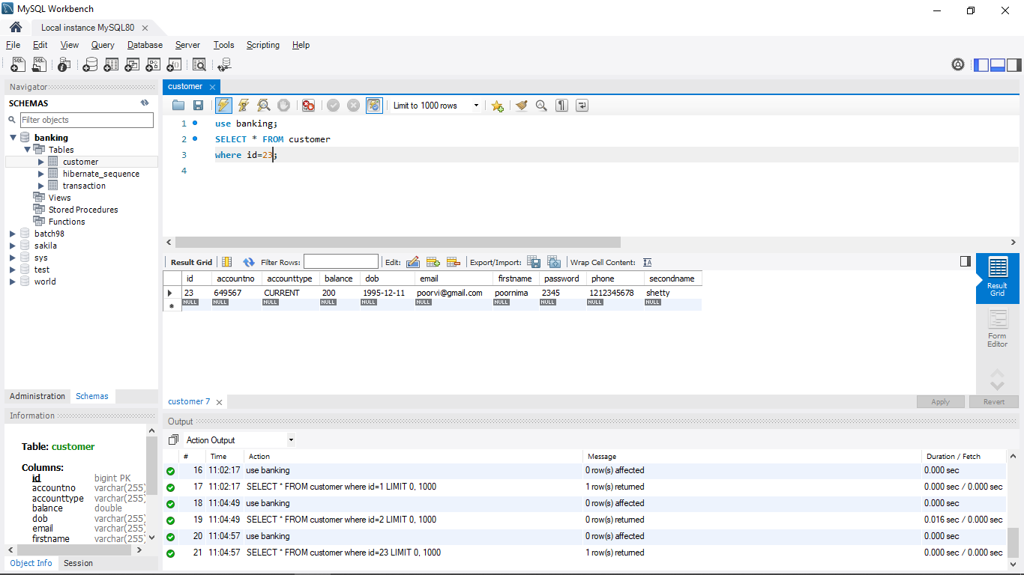
DATABASE AFTER WITHDRAWL
20

Slide 21
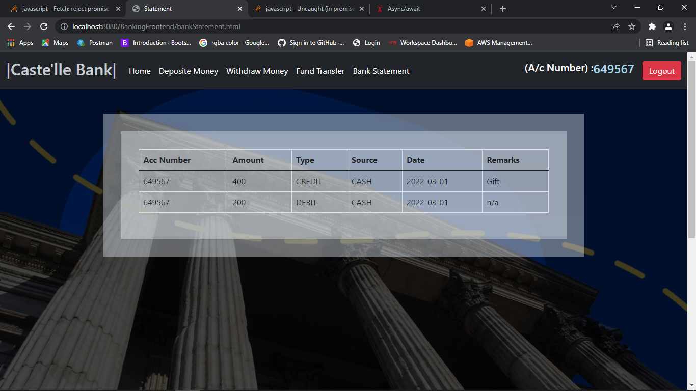
BANK STATEMENT OF 649567
21

Slide 22
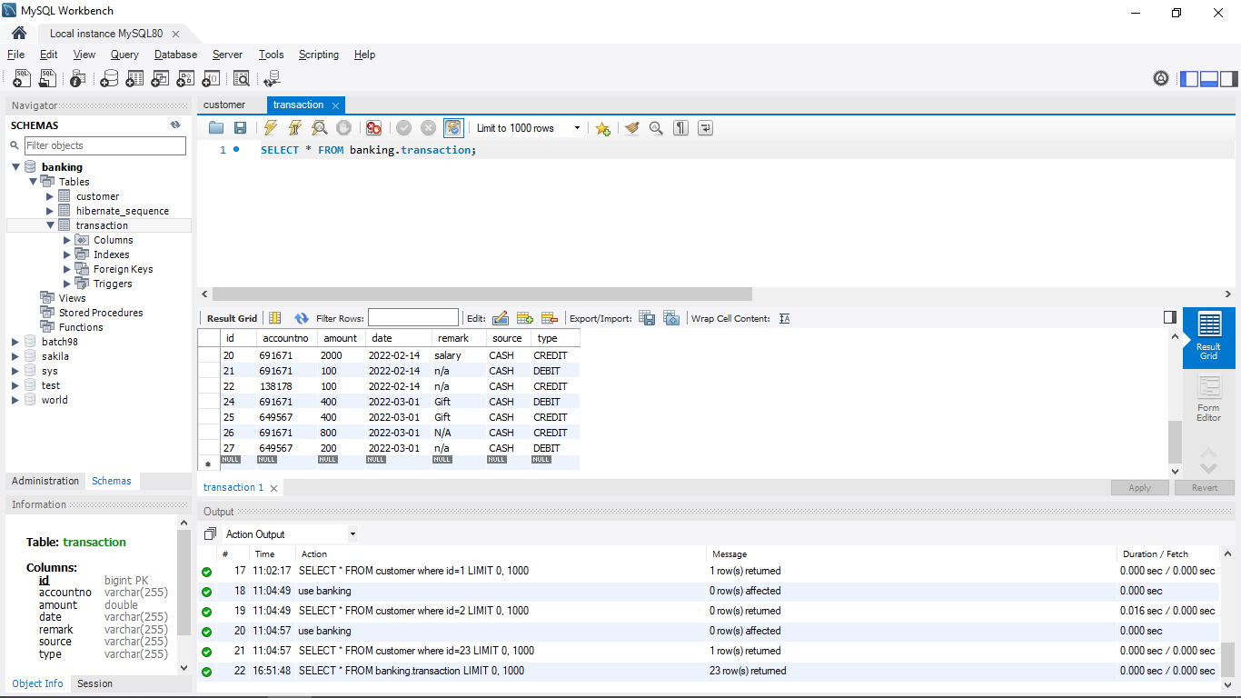
Transaction of all users
<number>

Slide 23

Thank you
<number>

